Slide 1
Software energy usage reporting
16.01.2019

Slide 2
Why?
World is facing global warming, ecological and energy crisis. I believe that everyone should feel responsible and take action to help to solve the problems.
Every watt counts and every energy unit (let it be Joules or kWh) spent is important. To start solving the problem we have to make the problem visible first. The goal is to create open source tools and solutions that could be used by developers and integrated to CI for continues monitoring.

Slide 3
Example
1 W electricity consumer
8.8 kWh consumed per year
  50 km drive with electric car
15 kg of oil shale has to be burned
1 EUR costs the electricity
8.8 W solar panels needed to produce the same energy
  Doesn’t take into account storage need due to day/night production and usage
15 EUR costs the PV-panels with installation
3W LED lamp 1h per day => 1 kWh / year

Slide 4
Plan
Figure out what data and metrics we need to take account.
Figure out what tools are needed to measure the energy usage in different scenarios.
Create tools (software and hardware) to measure the energy usage.
Tools which could be integrated to automated and end to end testing.
Tools which could be integrate to clients (web and native) to collect statistics continuously and make the results visible in graphs.
Introduce web browser plugin and browser API proposal to capture energy used by web page in browser tab since start.
Tools to be open sourced.

Slide 5
Metrics
Measure only software stack impact, don't take into account monitor or other external devices energy usage which we can't control
Take operating system and other applications power usage as baseline and find out how much running application adds to the usage.
We need to measure power in mW units scale.

Slide 6
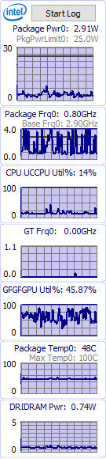
Existing tools
Intel® Power Gadget, measures Intel CPU + integrated GPU usage
API to query values or cmd-line to automate logging to file.
https://software.intel.com/en-us/articles/intel-power-gadget-20
Use Windows battery report in mWh units to calculate power usage (might take time to run tests and get results in mW units)
https://docs.microsoft.com/en-us/uwp/api/Windows.Devices.Power.BatteryReport
Use external HW based power meter

Slide 7
HW tools
There are expensive tools available on the market.
We need power meters which could be connected to PC for automated data acquisition.
DIY
EVALSTPM32 http://www.st.com/content/st_com/en/products/evaluation-tools/solution-evaluation-tools/energy-and-smartgrid-solution-eval-boards/evalstpm32.html
+ Isolated 3.3V power
+ https://github.com/mzeitler/openstrom

Slide 8
Proposal
Direct power measurement is not always available
We can measure CPU and GPU relative usage
We have to measure power usage for different CPU and GPU's and correlate it with relative CPU and GPU usage
Build up reverse lookup table to get actual power usage from CPU and GPU information

Slide 9
Math
https://en.wikipedia.org/wiki/CPU_power_dissipation
We need to collect CPU type (mapping => b_{CPU}, c_{CPU}), S₁ and S₂

Slide 10
GPU usage options
Browsing Performance Counters
https://msdn.microsoft.com/en-us/library/windows/desktop/aa371886(v=vs.85).aspx
D3DKMTQueryStatistics_T
https://forum.sysinternals.com/d3dkmtquerystatistics-t-buggy-on-multigpu-system_topic32543.html
GPU relative usage available in these tools
  Win10 ver 1709 Task Manager adds relative GPU usage stats, but not power usage
  SysInternals Process Explorer

Slide 11
CPU usage
Lots of options to query CPU usage per process in cycles and CPU time units.
Need to query CPU frequency too, to calculate actual power usage from CPU usage

Slide 12
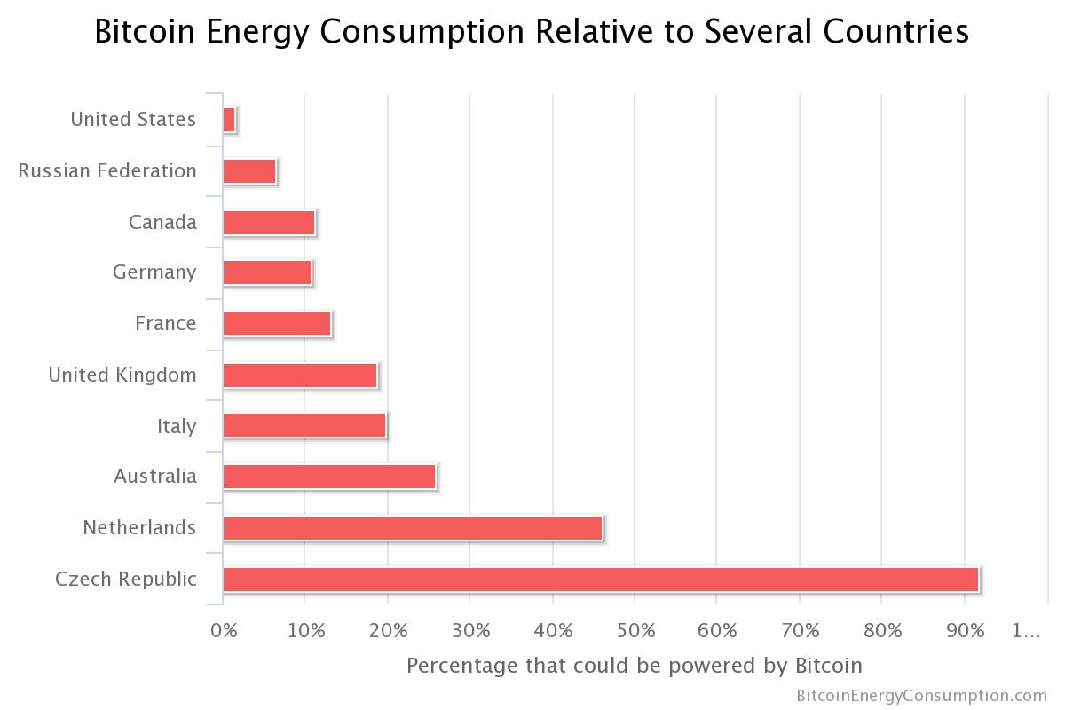
Bitcoin energy usage
61 TWh/year as of 23rd of April 2018

Slide 13
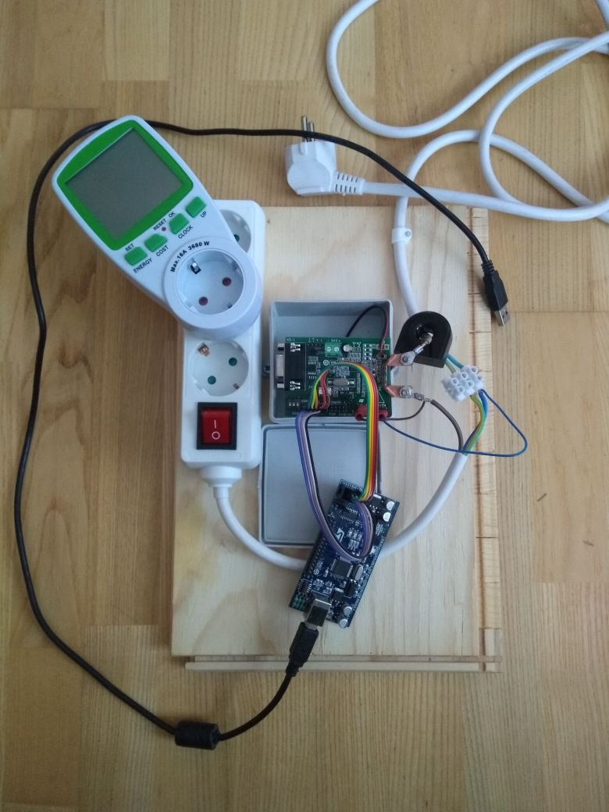
Lessons learned
With IPG it is easier to save each test logs to separate file and read summary from log
IPG causes video driver instability and PC restart is needed to use some software
With EVALSTPM32 don't assume that shunt sensor is connected to L-line and not to N.
HW built but SW not complete yet ->

Slide 14
TODO
Automate measurement taking
Complete HW
Take more measurements with different CPU/GPU combinations
Expose energy usage measurement results via performance counters

Slide 15
Sub projects
Calibration
  Tool for
    CPU, GPU and other components fingerprinting
    Using external HW for measuring correlation coefficients on different machines and platforms
Measurement library
  API for OS, process, thread level(Windows, Mac OSX, Chrome plugin)
  External tool(Windows, Mac OSX)
  Investigate PAPI (http://icl.cs.utk.edu/papi/index.html) PCM (https://github.com/opcm/pcm) To use and contribute?
Reporting Telemetry
  CSV, JSON, XML, TXT etc

Slide 16
API available
 | OS | Process | Thread
Windows | GetProcessorSystemCycleTime() | QueryProcessCycleTime() | QueryThreadCycleTime()
 | CallNtPowerInformation()

Slide 17
Results
PAPI direct usage no-go as Windows support was removed long time ago
MS Joulemeter, integrated into Visual Studio
Open PCM – Intel provided library for reading power values directly from CPU if supported. Requires kernel level driver and admin rights
Open Hardware Monitor – uses WinRing0.sys driver and admin rights to get access to low level CPU registers
psutil – multi platform Python library
gperftool – Google provided performance monitoring tools

